Slide 1
Independent Student Who Is Single and a Non-Tax Filer

Slide 2
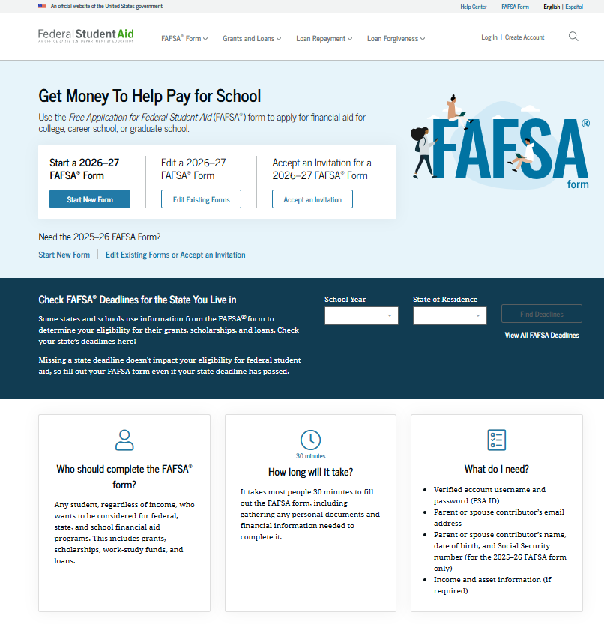
Independent Student: FAFSA® Form Landing Page
This is the main FAFSA® landing page. On this page, students are directed to "Start New Form," "Edit Existing Form," or "Accept an Invitation." For this section of the presentation, the student is beginning a new application.

Slide 3
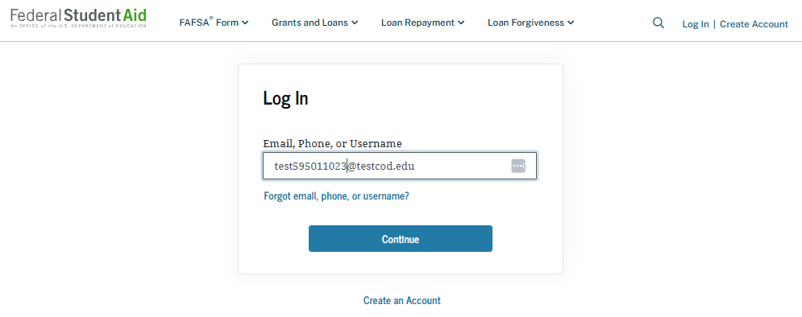
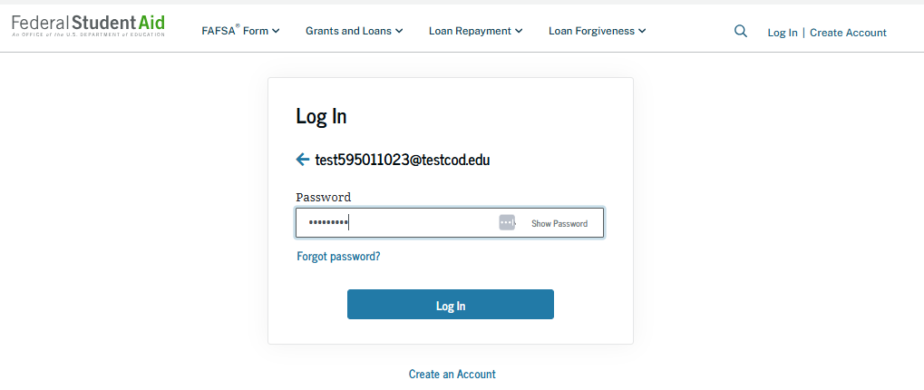
Independent Student: Log-in
If the student selects "Start New Form" on the FAFSA® landing page and they are not logged in to StudentAid.gov, the student is taken to the "Log In" page to enter their credentials. To access the FAFSA form, all students are required to have a StudentAid.gov account username and password. If the student doesn’t have a username and password, they can select "Create an Account."

Slide 4
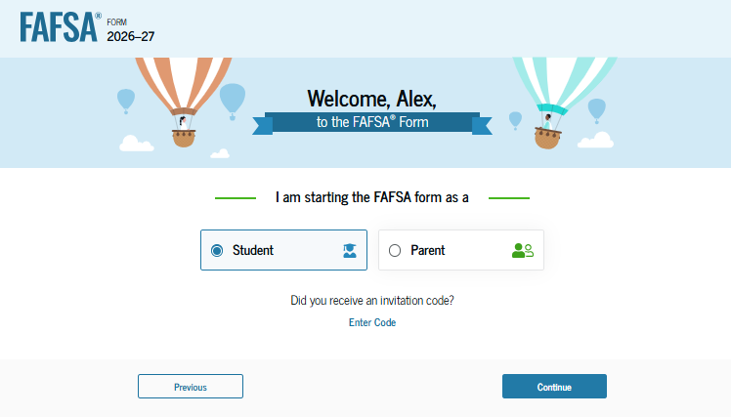
Independent Student: Roles
After logging in, the student can select the applicable role to fill out the FAFSA® form: "Student" or "Parent." The student also has the option to "Enter Code" if they received an invitation code. The student selects "Student."

Slide 5
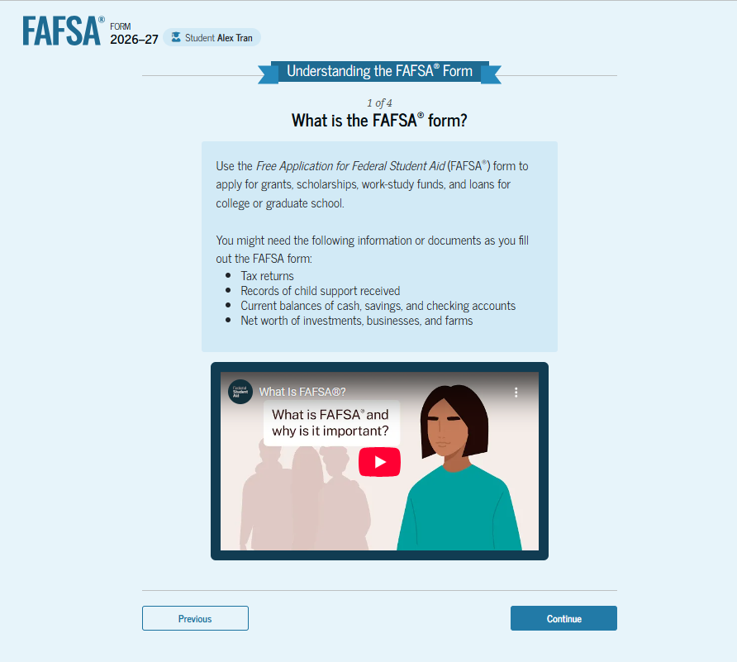
Independent Student: Onboarding (1 of 4)
When the student starts the 2026–27 FAFSA® form for the first time, they are taken through the FAFSA onboarding process. The first onboarding page provides an introduction of the FAFSA form and an accompanying video. Documents that may be needed to fill out the form are also listed on this page.

Slide 6
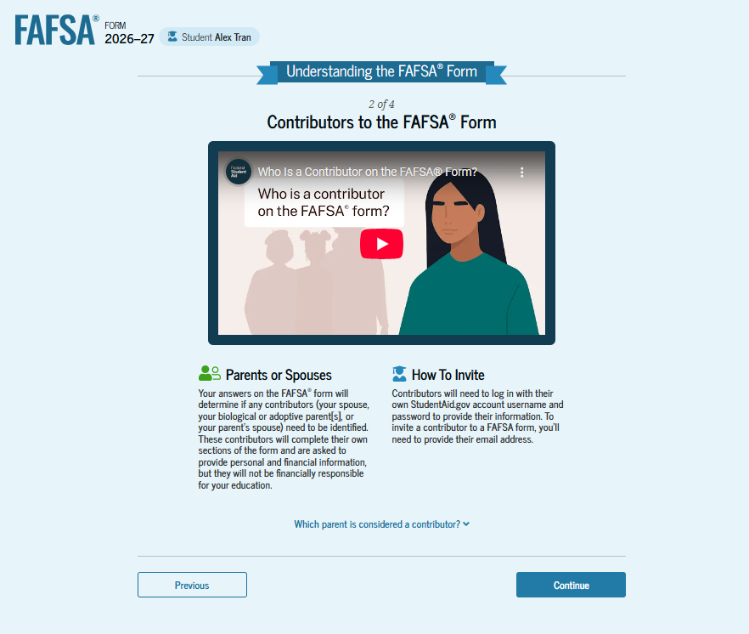
Independent Student: Onboarding (2 of 4)
The second FAFSA® onboarding page provides information and a video about contributors who may be required to participate on the student’s FAFSA form. This page also provides information about how the student will invite contributors to the FAFSA form.

Slide 7
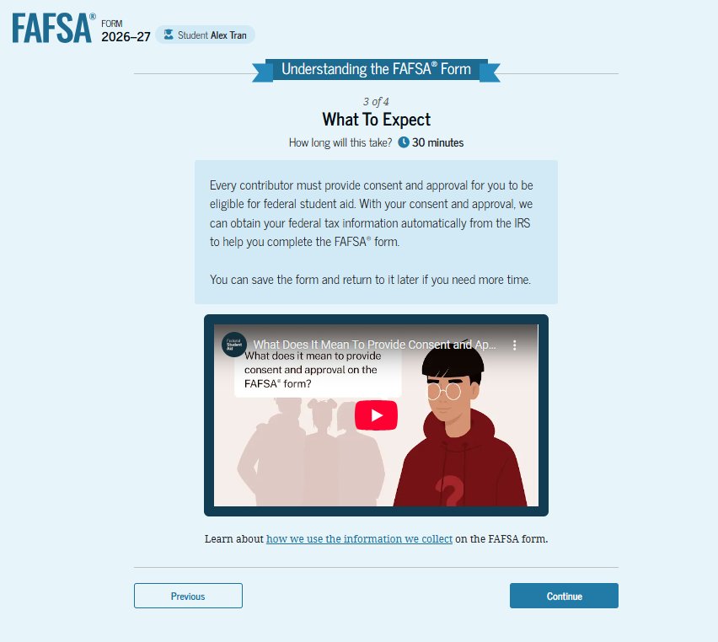
Independent Student: Onboarding (3 of 4)
The third FAFSA® onboarding page provides information about what the student can expect when completing the FAFSA form. This includes information about consent and approval, a time estimate for completing the form, and that the student can save the form and return later if needed, along with an accompanying video.

Slide 8
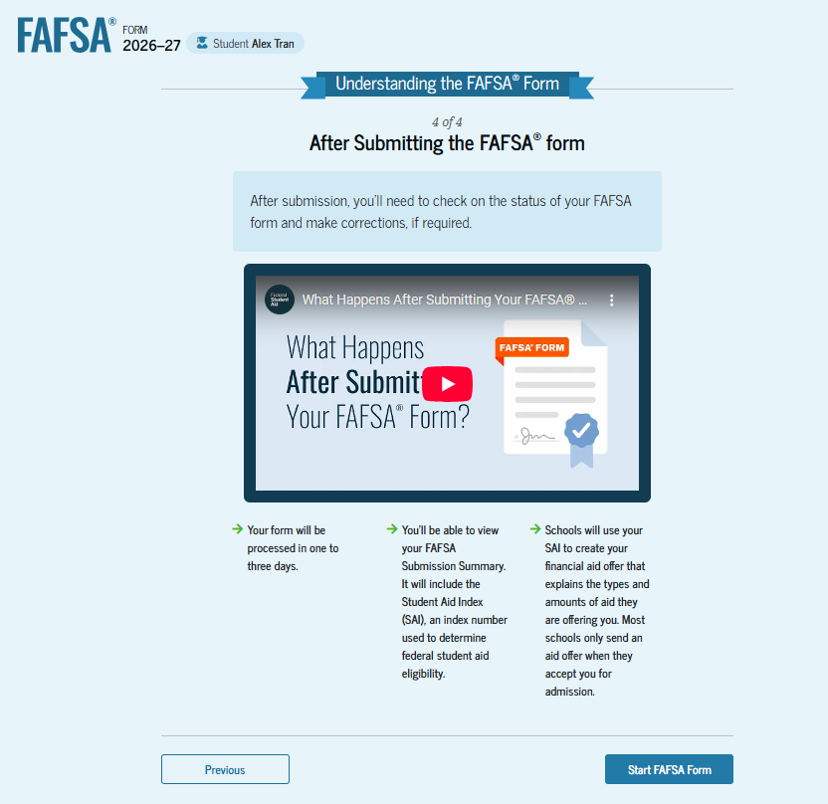
Independent Student: Onboarding (4 of 4)
The last FAFSA® onboarding page provides information and a video about what to expect once the FAFSA form is completed, submitted, and processed. On this page, the student can select "Start FAFSA Form" to begin.

Slide 9
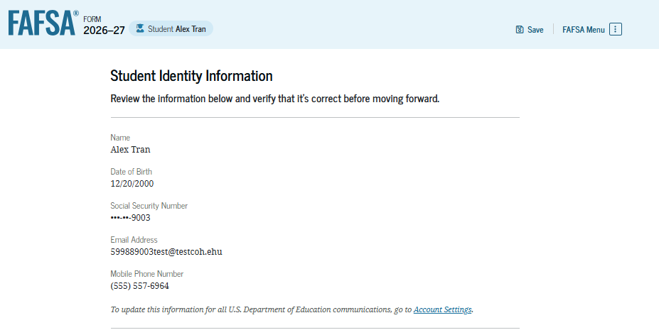
Independent Student: Student Identity Information
This is the first page within the student section. The student can verify that the personal information is correct. To update any of the personal information, the student must access their account settings on StudentAid.gov.

Slide 10
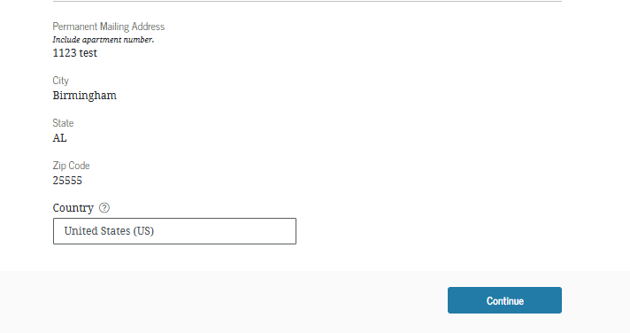
Independent Student:
Student Identity Information (Continued)
This is a continuation of the first page within the student section. The student can verify their mailing address on this part of the page. To update this information, the student must access their account settings on StudentAid.gov.

Slide 11
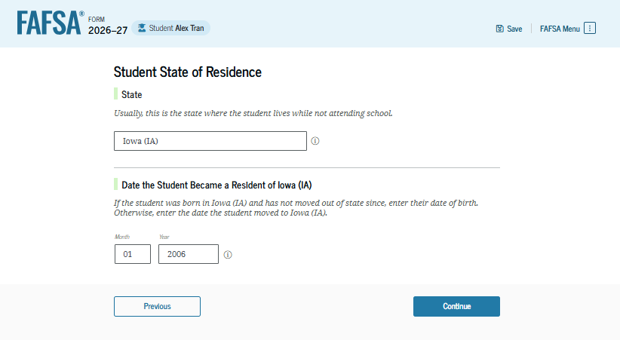
Independent Student: State Of Residence
The student is asked about their state of residence. The student selects the state from a drop-down box and provides the month and year when they became a resident.

Slide 12
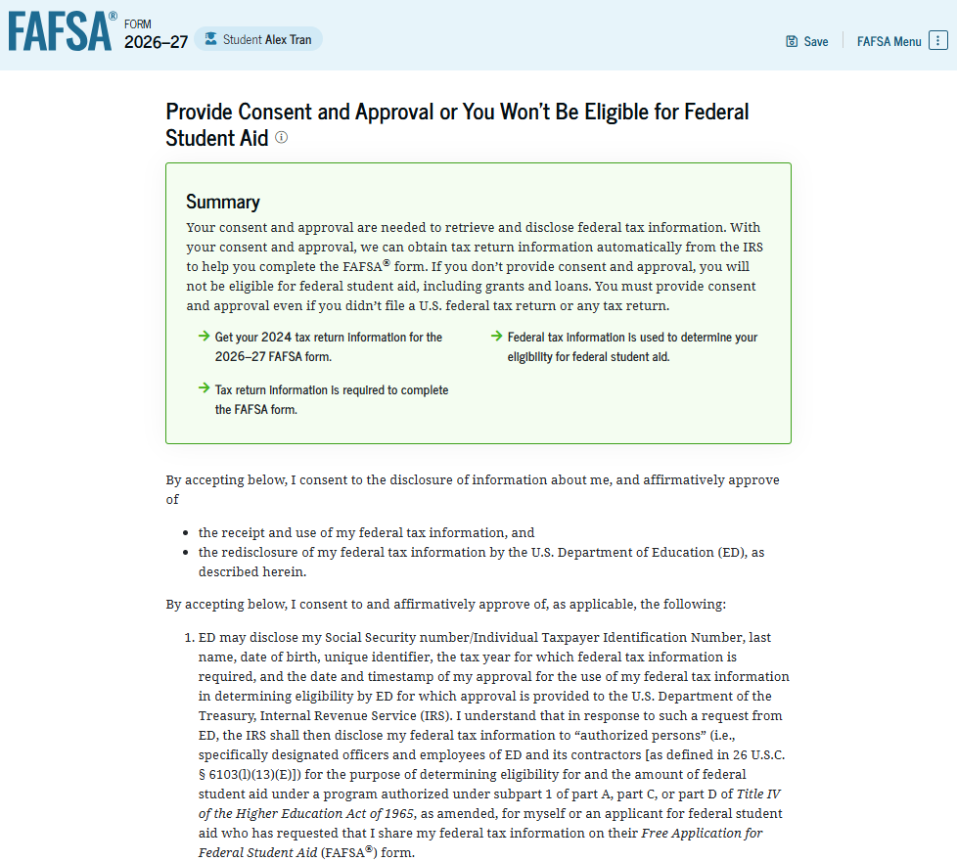
Independent Student: Provide Consent and Approval
This page informs the student about consent, approval, and the use of federal tax information. By providing consent and approval, the student’s federal tax information is transferred directly from the IRS into the FAFSA® form to help complete the "Your Finances" section.

Slide 13
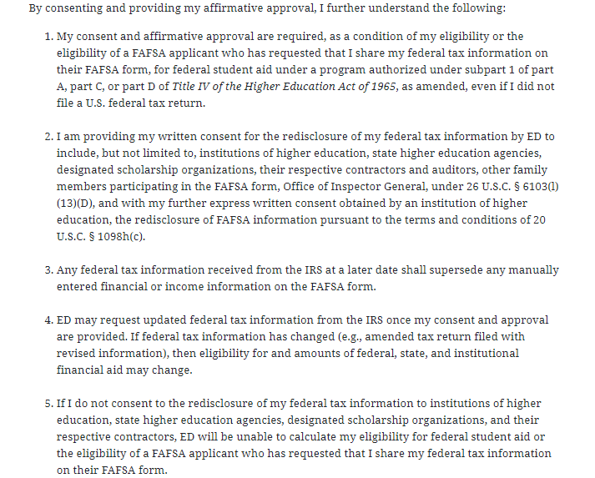
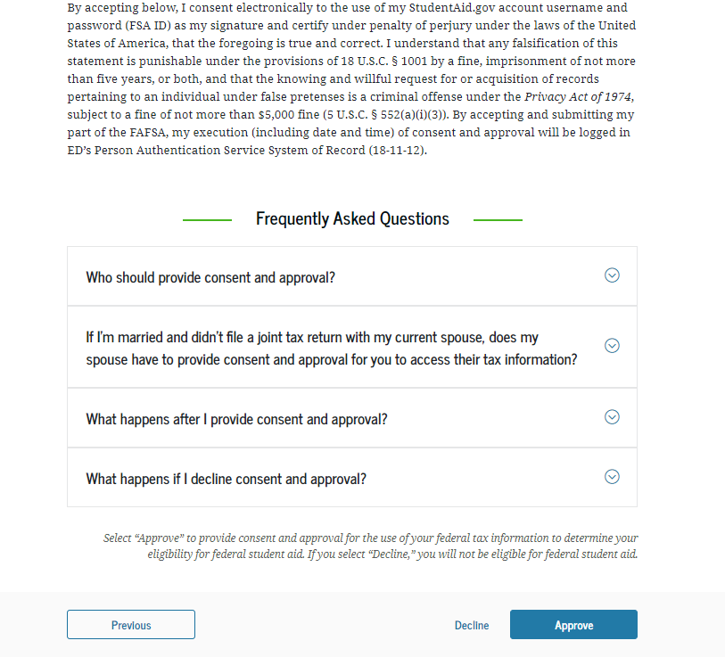
Independent Student: Provide Consent and Approval (Continued)
This is a continuation of the consent and approval page. Frequently asked questions about consent and approval are provided that the student can expand and collapse. The student selects "Approve" to provide consent and approval and is taken to the next page.

Slide 14
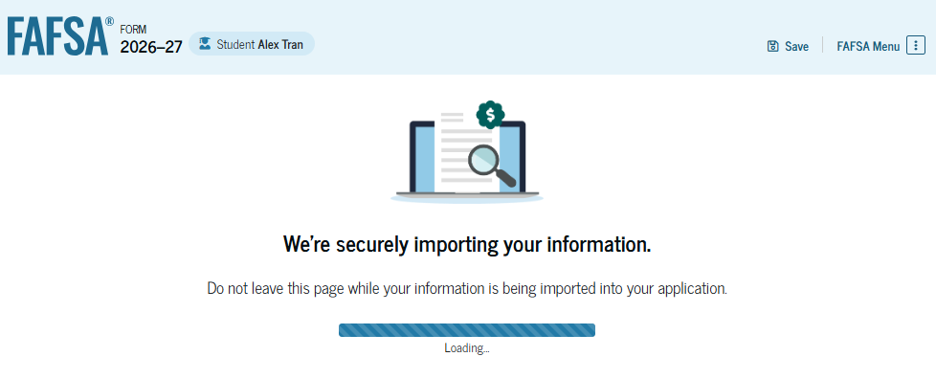
Independent Student: Imports IRS Information
This page imports the student’s federal tax information by directly transferring it from the IRS into the FAFSA® form to help complete the "Your Finances" section.

Slide 15
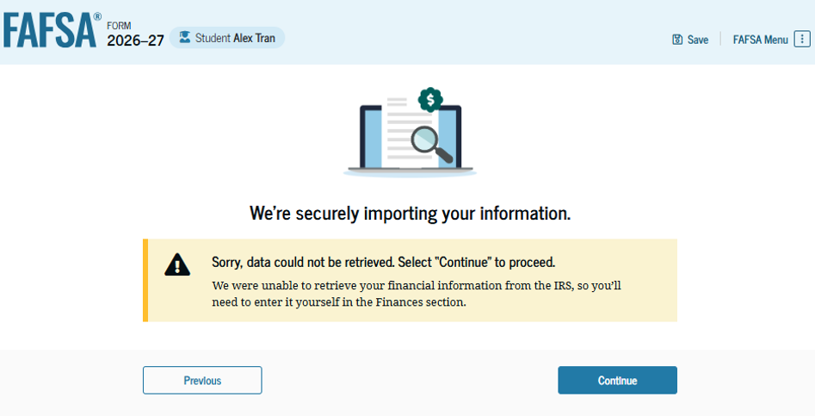
Independent Student:
Imports IRS Information (Continued)
This page displays the results from the IRS import for the student. For this scenario, the student is starting a new FAFSA® form and there is no federal tax information available from the IRS.

Slide 16
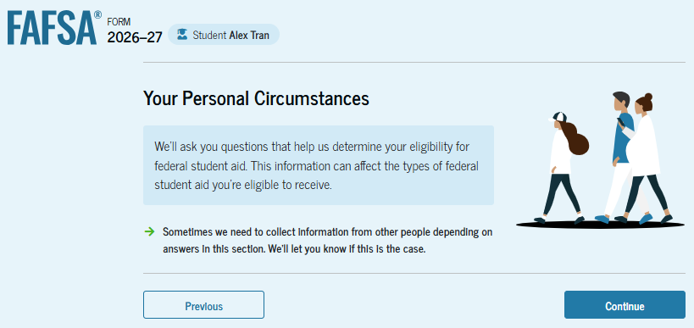
Introduction: Independent Student Personal Circumstances
This is the first page within the "Your Personal Circumstances" section. It provides an overview of the section.

Slide 17
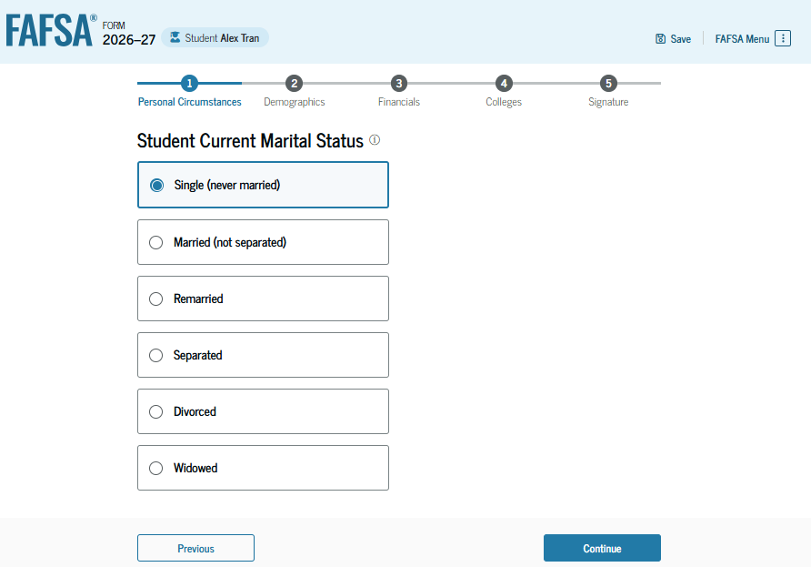
Independent Student: Marital Status
The student is asked about their marital status. The student selects the "Single (never married)" option.

Slide 18
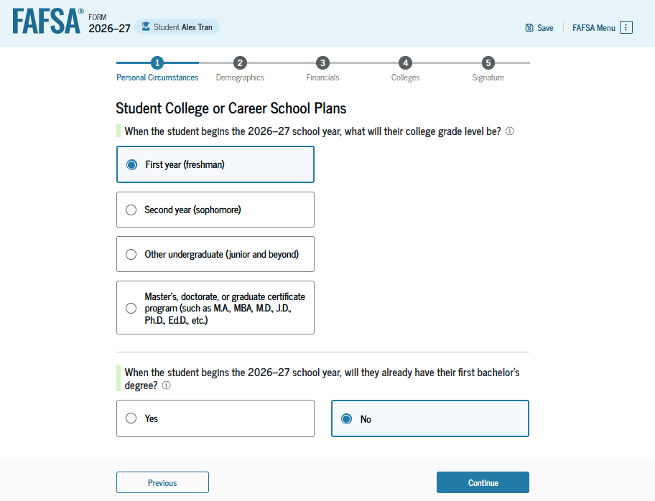
Independent Student: College or Career School Plans
The student is asked about their college grade level for the 2026–27 school year and if the student will have their first bachelor’s degree. The student selects "First year (freshman)" and "No" to the question about the student’s first bachelor’s degree.

Slide 19
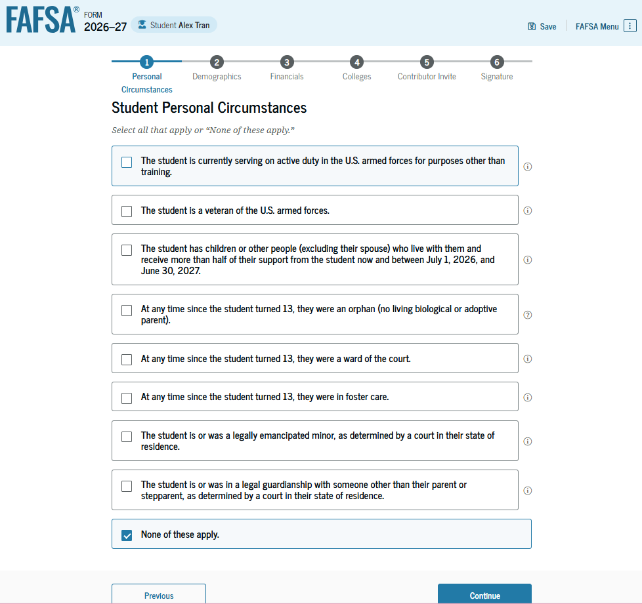
Independent Student: Personal Circumstances
The student is asked if any of the listed personal circumstances apply. The student selects "None of these apply."

Slide 20
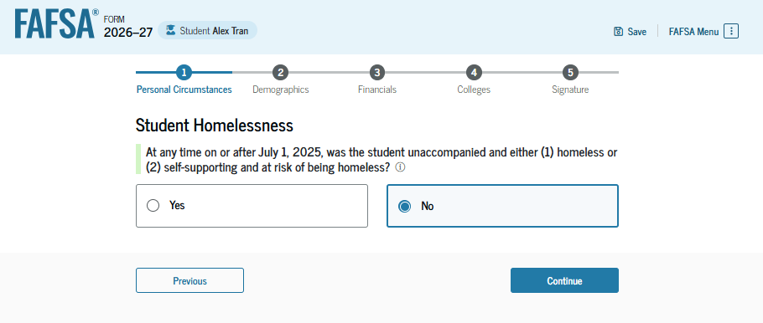
Independent Student: Homelessness Status
The student is asked if they were homeless or at risk of being homeless. The student selects "No."

Slide 21
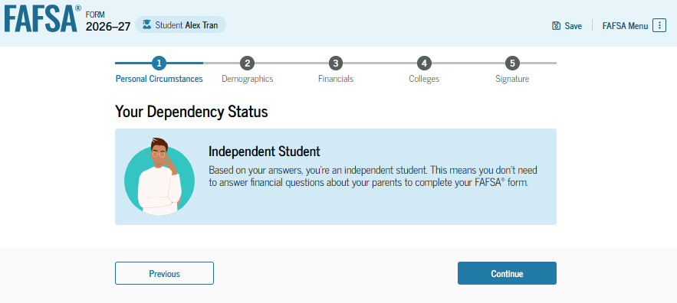
Student Dependency Status: Independent Student
Because the student’s date of birth is before Jan. 1, 2003, the student is considered an independent student. The student is not required to provide information about their parents due to this status.

Slide 22
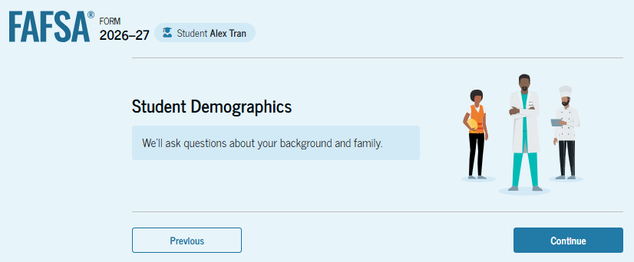
Introduction: Independent Student Demographics
This is the first page within the "Student Demographics" section. It provides an overview of the section.

Slide 23
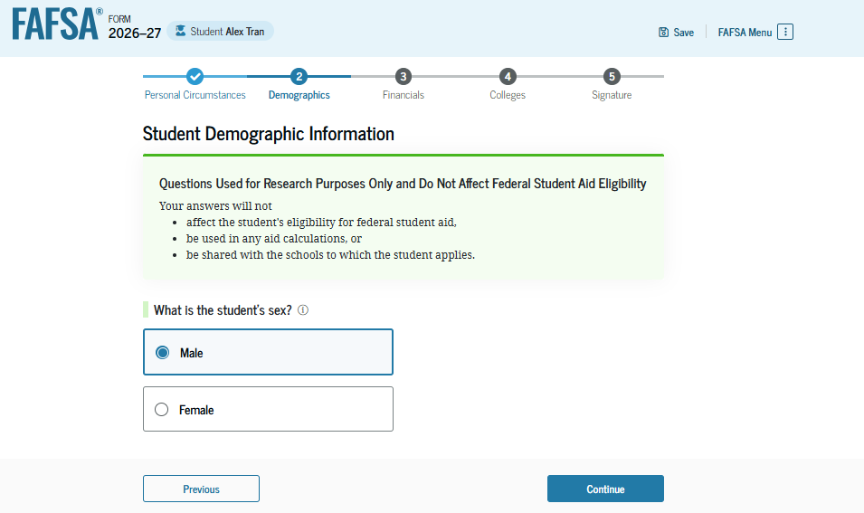
Independent Student: Demographic Information
The student is asked to identify their sex. The student selects "Male."

Slide 24
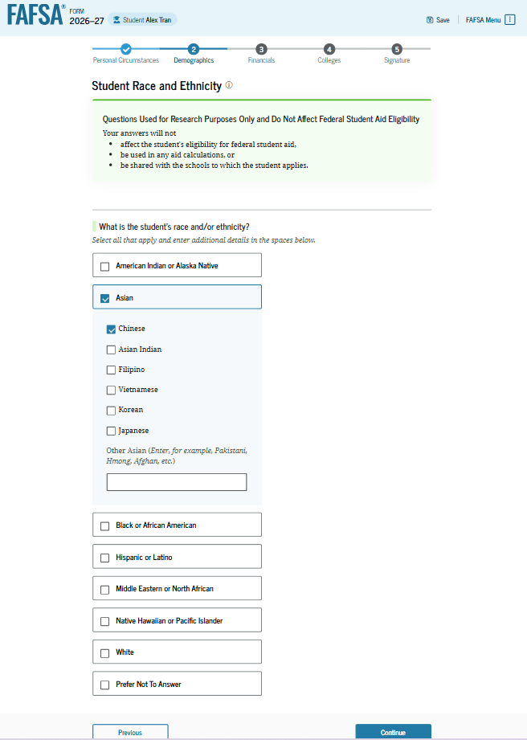
Independent Student: Race and Ethnicity
The student is asked to identify their race. The student selects the checkboxes that apply. After making a selection, a second drop-down box appears, and the student selects the checkboxes that apply.

Slide 25
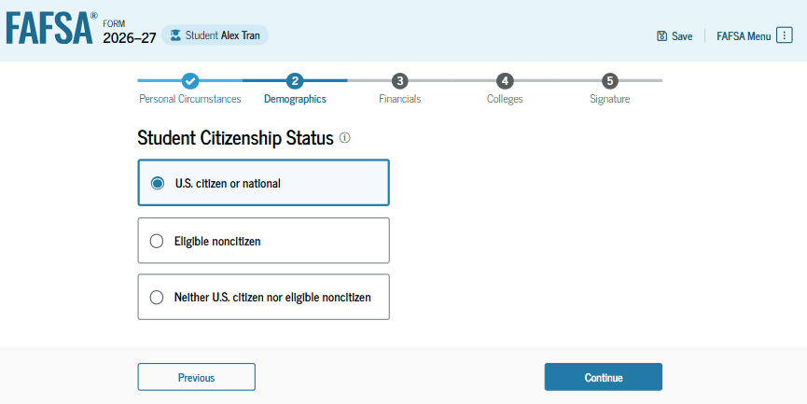
Independent Student: Citizenship Status
The student is asked about their citizenship status. The student selects the "U.S. citizen or national" option.

Slide 26
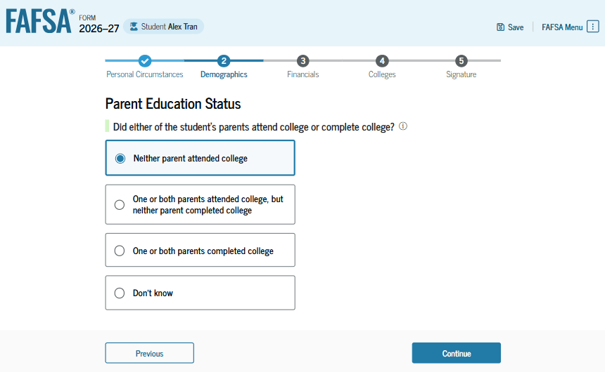
Independent Student: Parent Education Status
The student is asked about their parents’ education status. The student selects the "Neither parent attended college" option.

Slide 27
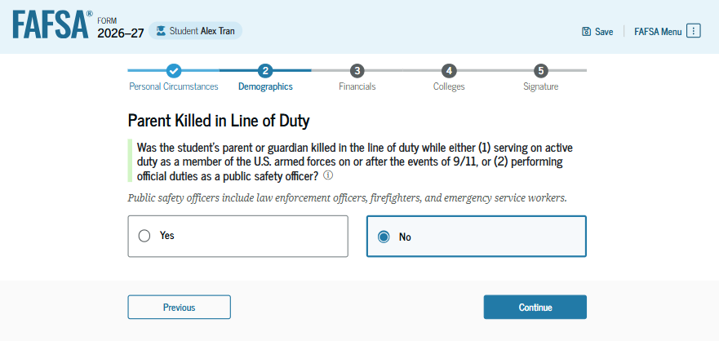
Independent Student: Parent Killed in Line of Duty
Since the student is under the age of 33, the student is asked if their parent was killed in the line of duty. The student selects the "No" option.

Slide 28
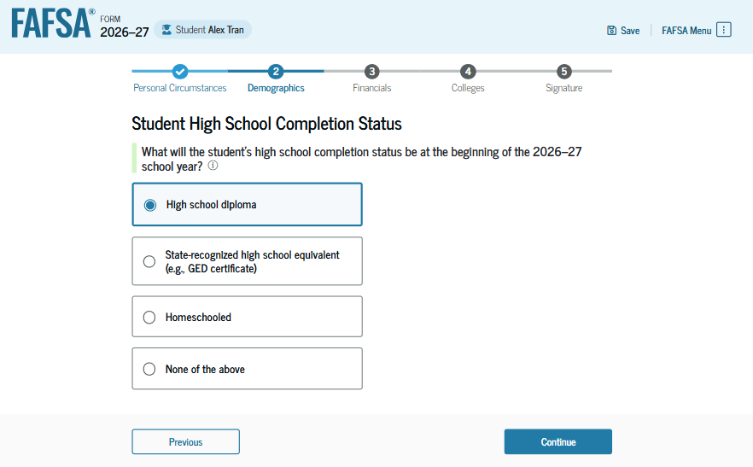
Independent Student: High School Completion Status
The student is asked about what their high school completion status will be when the student starts the 2026–27 school year. The student selects the "High school diploma" option.

Slide 29
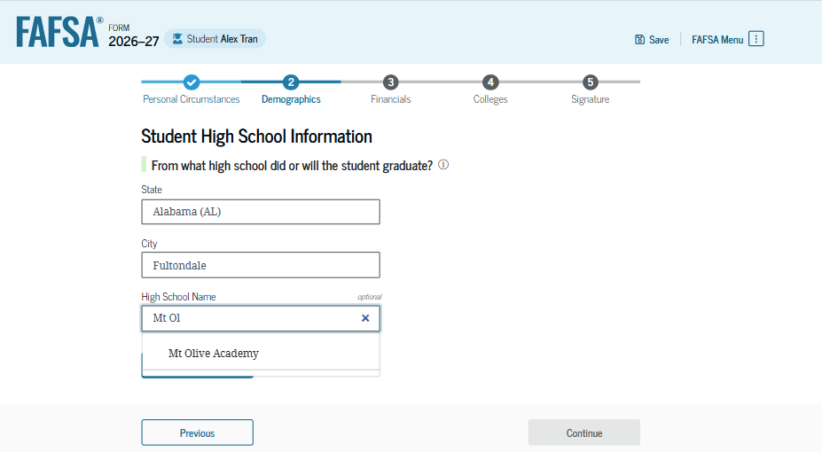
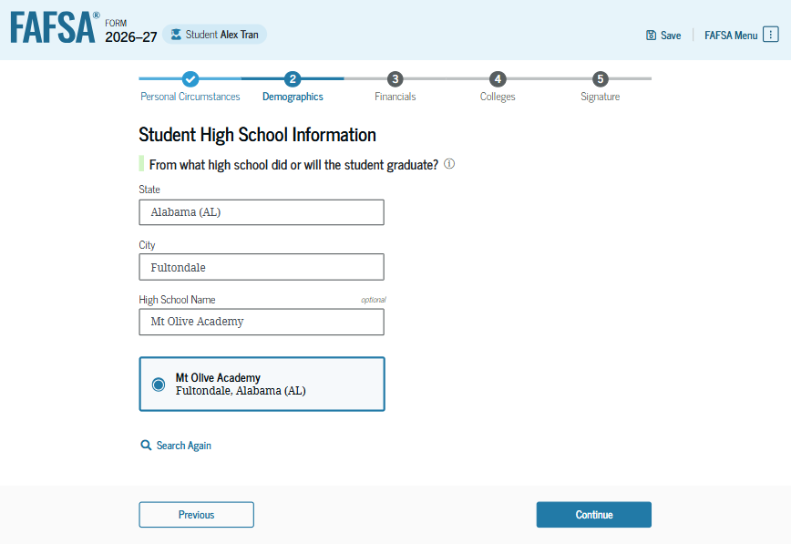
Independent Student: High School Information
Because the student selected "High school diploma," the student is asked to select the high school from which they did or will graduate. The student enters the high school’s state and city. After selecting "Search," the student selects the correct high school from the search results.

Slide 30
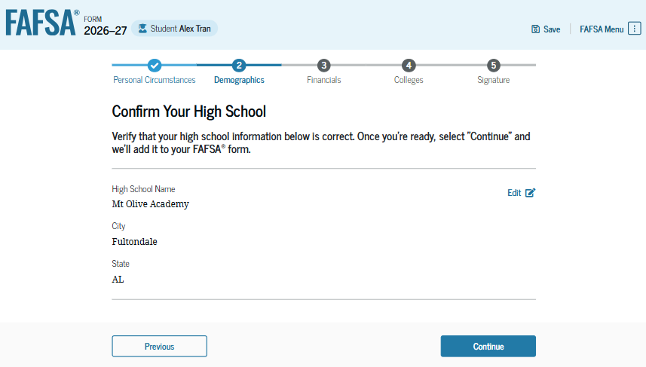
Independent Student: Confirms High School
The student has the option to edit the high school information presented on this page by selecting "Edit," which will return the student to the high school information page. The student confirms the high school information and selects "Continue" to proceed to the next section.

Slide 31
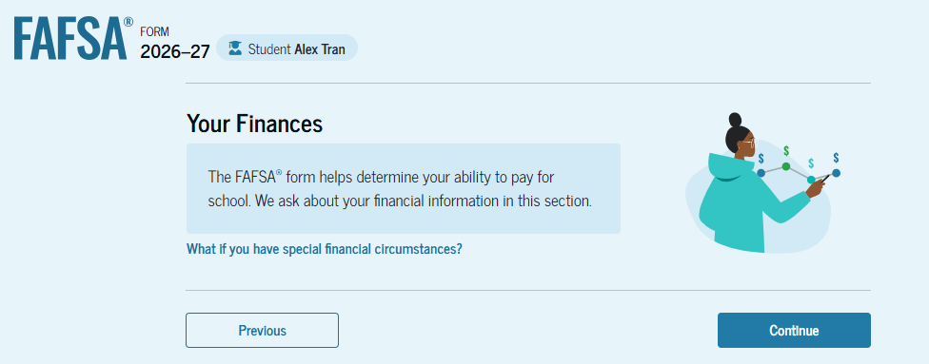
Introduction: Independent Student Financials
This is the first page within the "Your Finances" section; it provides an overview of the section. The student can select the hyperlink to learn about special financial circumstances.

Slide 32
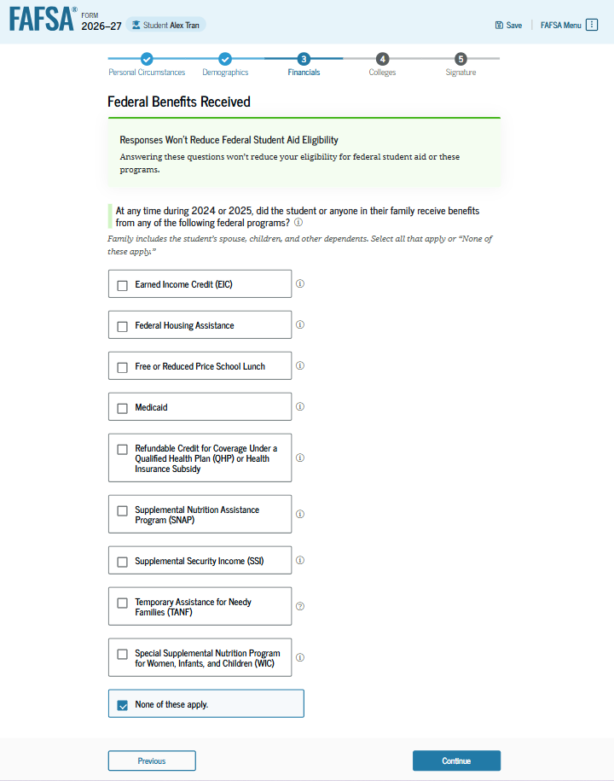
Independent Student: Federal Benefits
The student is asked if the student or anyone in their family has received federal benefits. The student selects “None of these apply.”

Slide 33
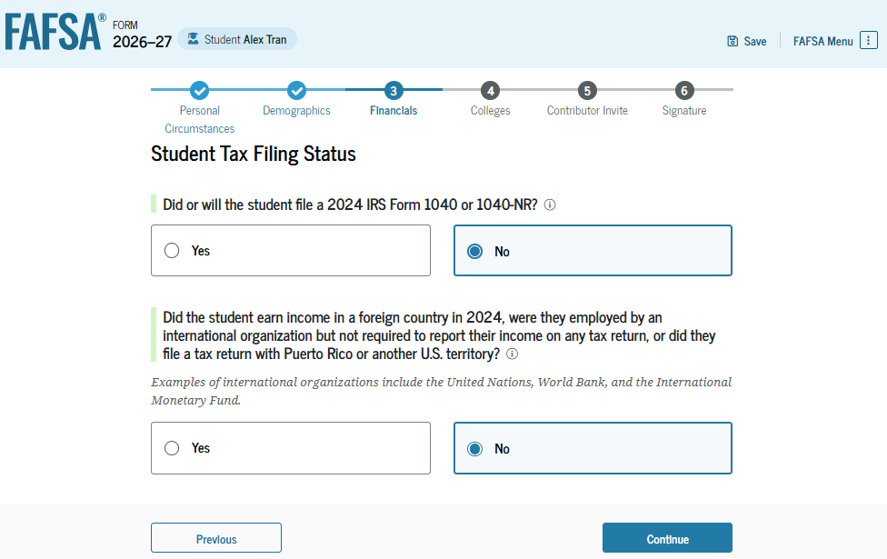
Independent Student: Tax Filing Status
This page asks the student about their tax filing status. The student selects "No" to "Did or will the student file a 2024 IRS Form 1040 or 1040-NR?" Because of this selection, the student is asked if they earned income in a foreign country, were employed by an international organization but not required to report income on any tax return, or filed a tax return with Puerto Rico or another U.S. territory. The student selects "No."

Slide 34
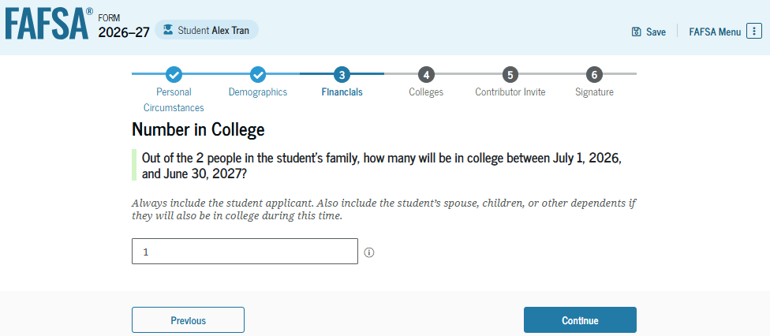
Independent Student: Number in College
This page asks the student how many people in the family will be in college between July 1, 2026, and June 30, 2027. The student enters a response in the entry field.

Slide 35
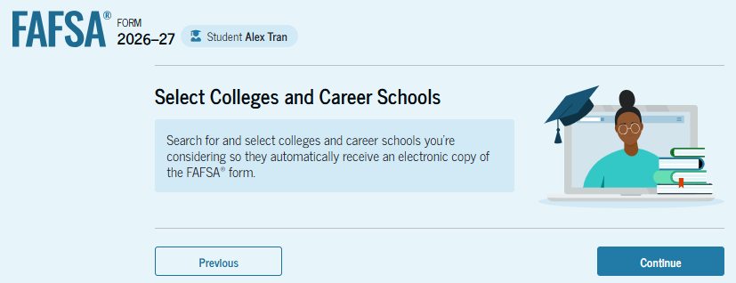
Introduction: Independent Student Select Colleges
This is the first page in the "Select Colleges and Career Schools" section. It provides an overview of the section.

Slide 36
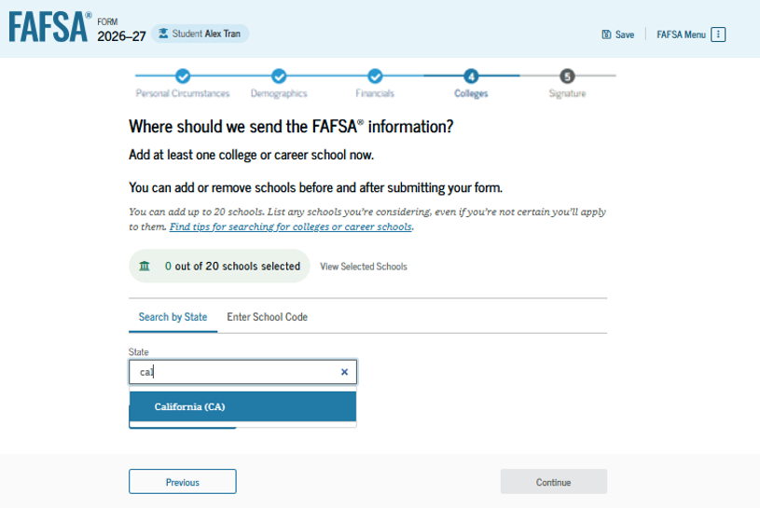
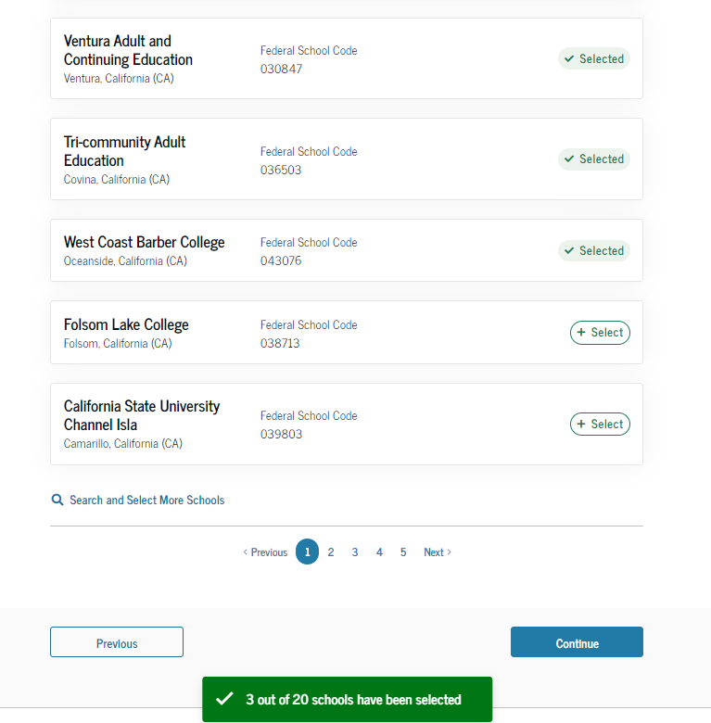
Independent Student: College Search
The student is asked to search for the colleges, career schools, or trade schools that will receive their FAFSA® information. The student searches for a school by entering a state, city, and/or school name. After selecting "Search," the student selects the correct school(s) from the search results. Students can send their FAFSA information to a maximum of 20 schools. The student must add at least
one school to continue.

Slide 37
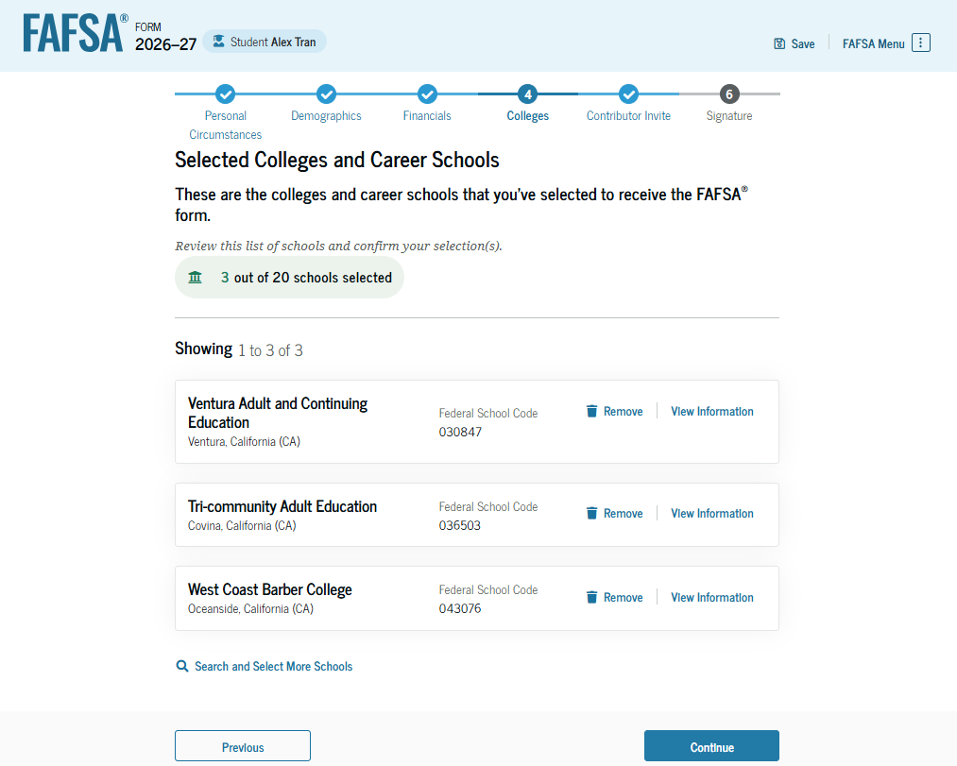
Independent Student: Selected Colleges
The student can view the school(s) they selected. If 20 schools were not selected, the student has the option to search and select more schools, and, in some states, the student has the option to reorder the list of selected schools.

Slide 38
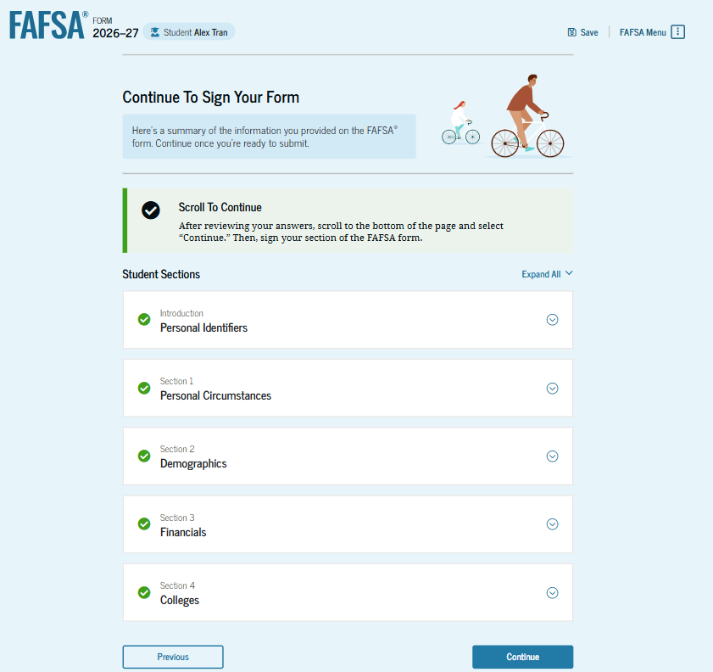
Independent Student: Review Page
The review page displays the responses that the student has provided in the FAFSA® form. The student can view all responses by selecting "Expand All" or expand each section individually. To edit a response, the student can select the question’s hyperlink to be taken to the corresponding page.

Slide 39
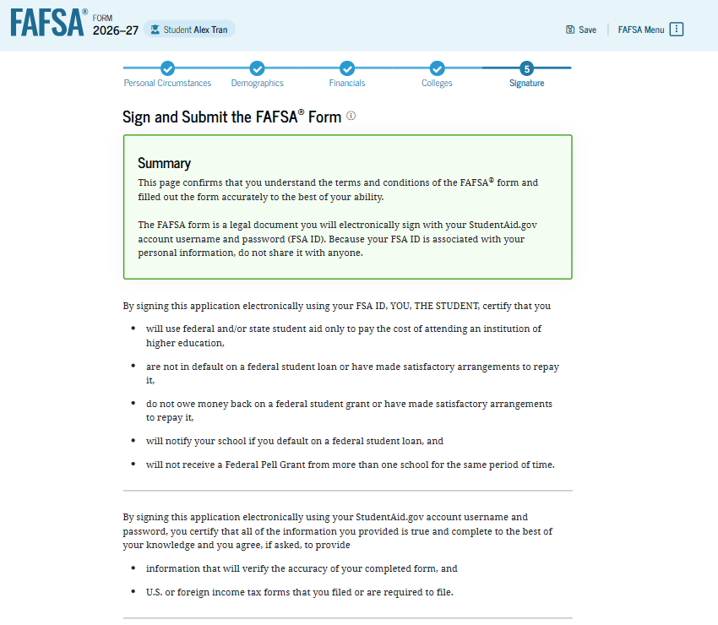
Independent Student: Signature
On this page, the student reviews the terms and conditions of the FAFSA® form and what they’ll agree to when the student signs the form.

Slide 40
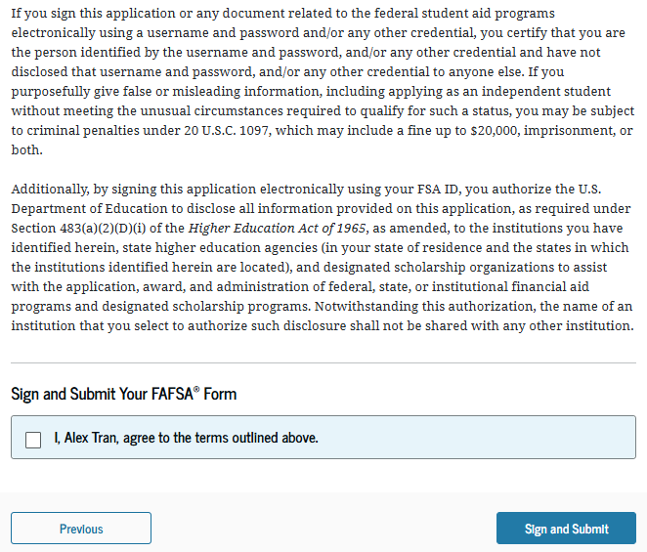
Independent Student: Signature (Continued)
This is a continuation of the student signature page. After agreeing to the terms and conditions of the FAFSA® form and digitally signing, the student can submit their sections of the FAFSA form. Since all required sections are complete, the student can both sign and submit the FAFSA form.

Slide 41
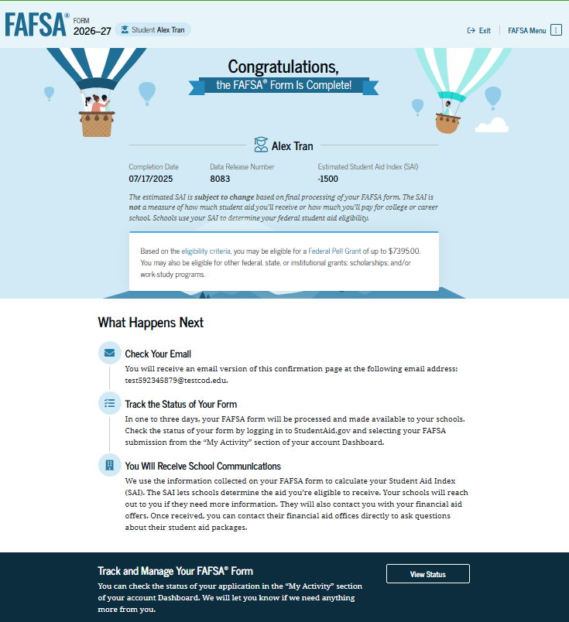
Independent Student: Confirmation Page
The student is presented with the confirmation page. This page displays information for the student about the completion date and data release number for their FAFSA® form, along with an estimate for the student’s Student Aid Index. The student is informed they may be eligible for a Federal Pell Grant, which may be a result of their negative SAI.

Slide 42
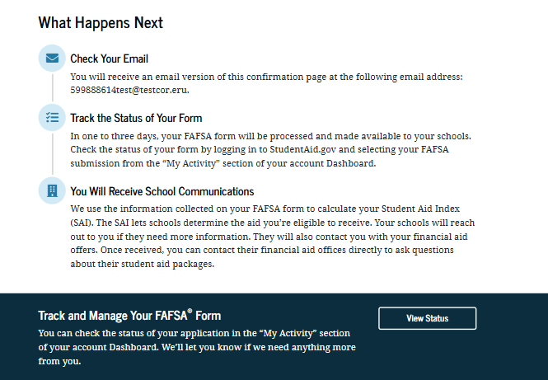
Independent Student: Confirmation Page (Continued)
This is a continuation of the student section complete page. This page displays information for the student about next steps, including checking their email, tracking the FAFSA® form, and receiving communications from their school(s).

